Slide 1

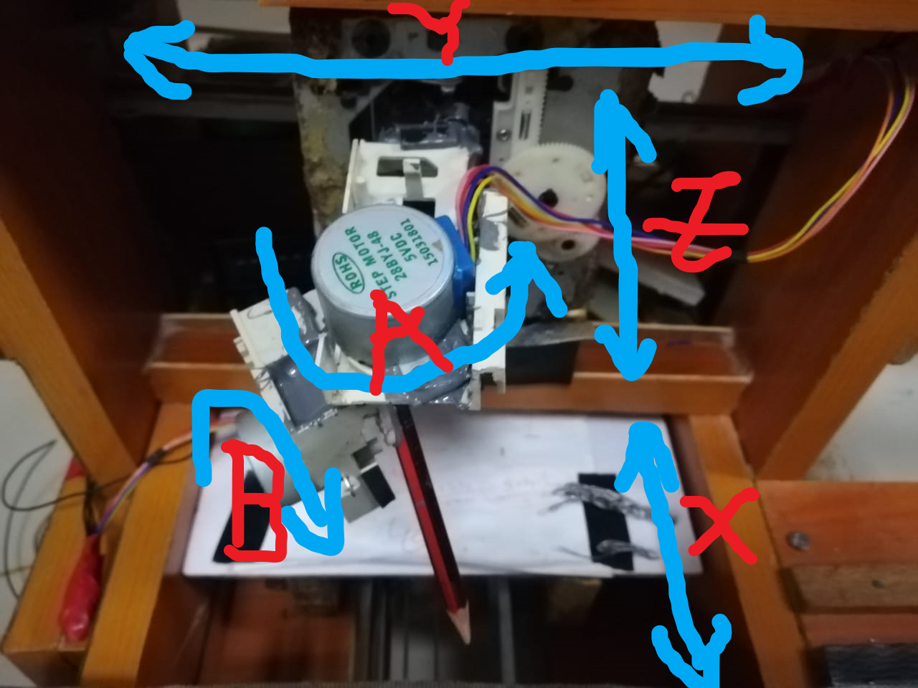
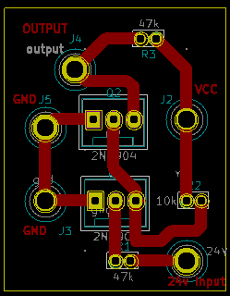
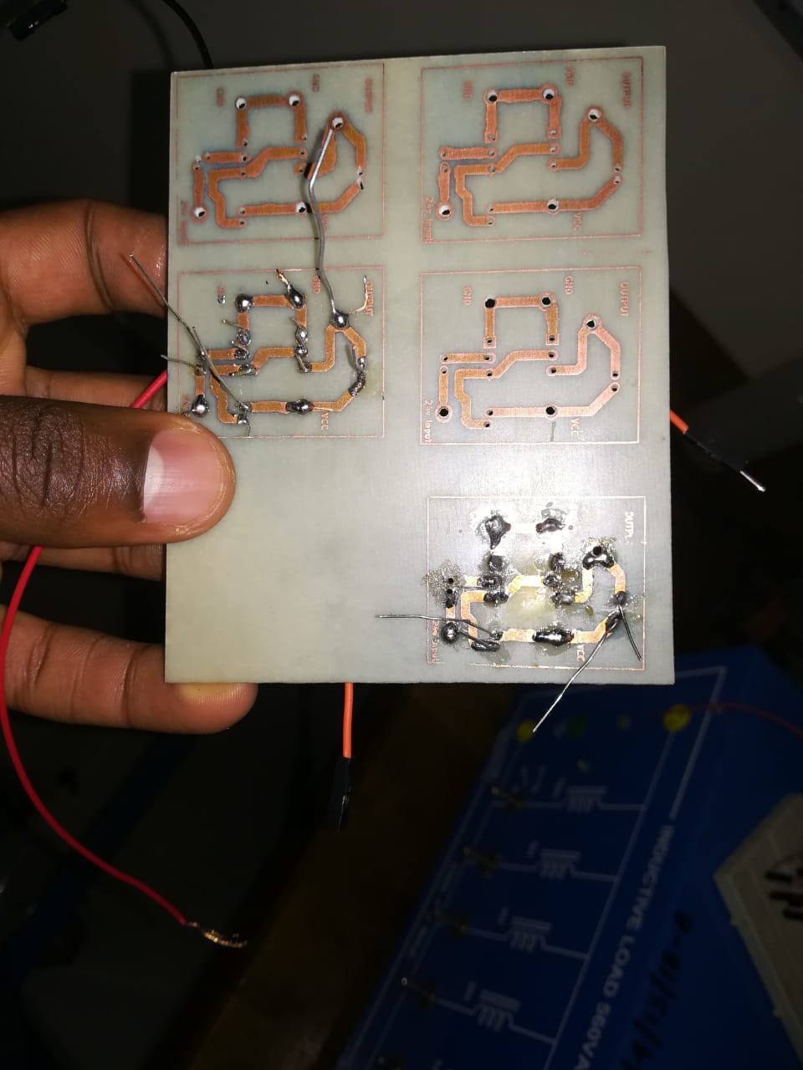
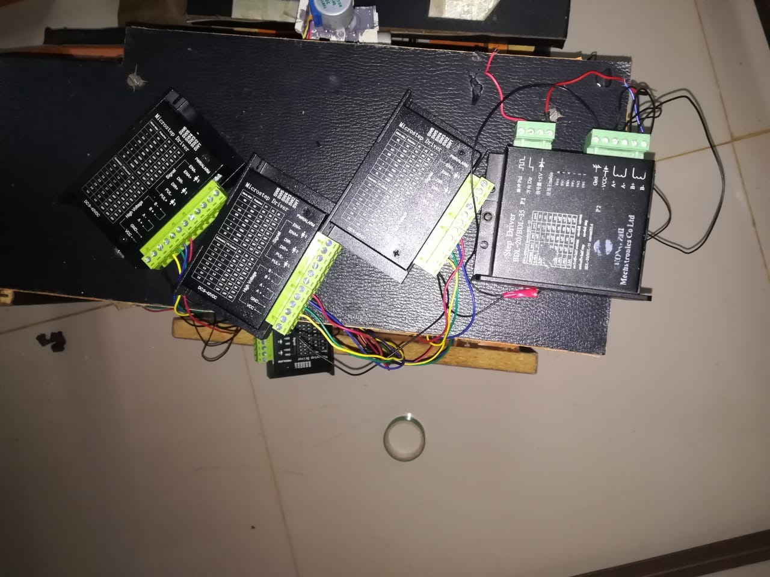
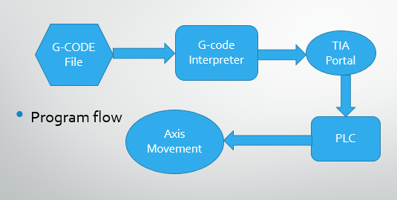
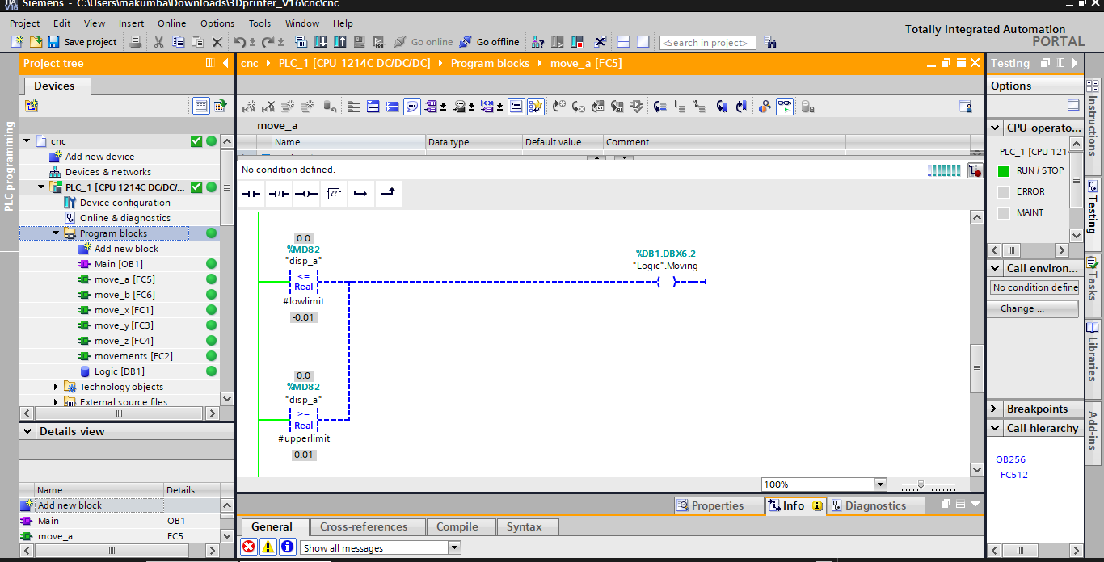
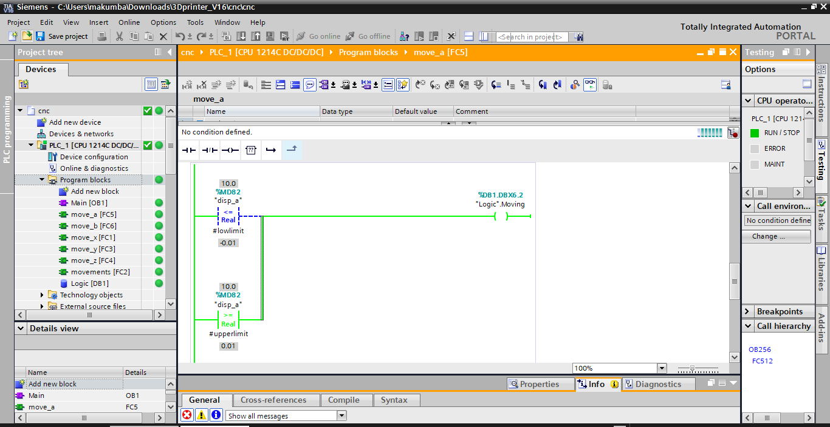
Designing A 5-Axis CNC system
Simon Muraya, Oscar Momanyi, Kelvin Mugo
1. Introduction
Computer numerical control machining is a process that enables easier machining of intricate parts aiding in the advancements in the automation industry.
Many companies seek CNC machining for their operations so they can follow through on accurate designs and make precise pieces with computer software. However the cost of a CNC machine is quite high. Take it for example we only had super computers existing and I only need a computer for studying…imagine the cost verses the output.
Objectives:
To test G-code on the physical system that shows motion in all the 5-axes.
5-Axis CNC Machine:
This is a physical representation of a 5-axis CNC machine that moves in all the 5 axes.
2. Circuit Analysis
A picture of the motor drives interconnected.
Measurement process of discharge pulses:
The Pulse and Direction ports of the Stepper motor drives requires a constant voltage of 5V for efficient running. The ouput from the PLC is thus stepped down from 24V to 5v.
3. Results
CONTROL PROGRAM
The G-code file is read by python program which then writes the data to the specific data blocks/ memory locations on the PLC via TIA Portal hence causing movement on the axes.
The CNC machine was able to move in all the 5-axes of motion. Therefore, with this machine anyone can observe and test the G-code on any axis. This machine is a simplified version that can be used to perform CNC operations in the 5-axes on a small scale level as well as increase interaction time in institutions as its quite affordable.
4. Conclusion
Supervisor: Prof Jean Bosco

